Slide 1
Threads, SMP, and Microkernels
Chapter 4

Slide 2
Multithreading
Operating system supports multiple threads of execution within a single process
MS-DOS supports a single thread
UNIX supports multiple user processes but only supports one thread per process
Windows 2000, Solaris, Linux, Mach, and OS/2 support multiple threads

Slide 3
Modern Process & Thread
Divide classic process:
  Process is an infrastructure in which execution takes place → (address space + resources)
  Thread is a program in execution within a process context – each thread has its own stack
Stack
Data
Thread
Thread
Stack
Process
…
Program
Stack
Thread
Operating System

Slide 4
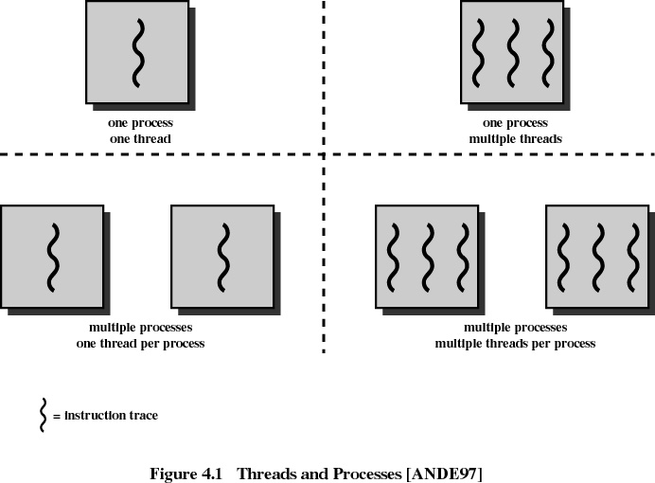

Slide 5
Thread
(Lightweight Process)
An execution state (running, ready, etc.)
Saved thread context when not running
Has an execution stack
Some per-thread static storage for local variables
Access to the memory and resources of its process
  all threads of a process share this

Slide 6
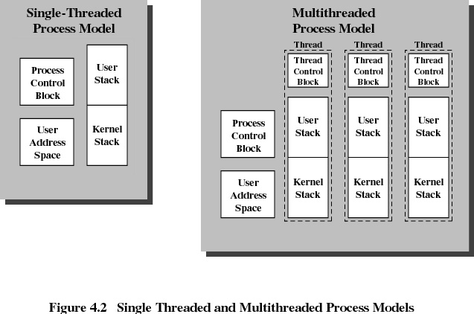

Slide 7
Benefits of Threads
Takes less time to create a new thread than a process
Less time to terminate a thread than a process
Less time to switch between two threads within the same process
Since threads within the same process share memory and files, they can communicate with each other without invoking the kernel

Slide 8
Shared Address Space
Thread model simplifies the problem
  All threads in a process implicitly use that process’s address space , but no “unrelated threads” have access to the address space
  Now trivial for threads to share a program and data
    If you want sharing, encode your work as threads in a process
    If you do not want sharing, place threads in separate processes

Slide 9
Threads in a Single-User Multiprocessing System
Foreground to background work
(spreadsheet: one thread reading user input, another executing the commands and updating the spreadsheet)
Asynchronous processing
(ex: a thread performing periodic backups against power failures in a word-processor)
Speed execution
(on a Multiprocessor system, multiple threads can execute in parallel)
Modular program structure
(different tasks/activities in a program may be implemented using different threads)

Slide 10
**here Threads
If a process is swapped out, all of its threads are necessarily swapped out because they all share the address space of the process
Termination of a process, terminates all threads within that process
In general, blocking of a thread does not necessarily block the parent process or the other threads

Slide 11
User-Level Threads (ULT)
All thread management is done by the application
The kernel is not aware of the existence of threads
Disadvantages:
  when a ULT executes a blocking system call, all of the threads within the same process are blocked
  can not take advantage of multiprocessing

Slide 12
Kernel-Level Threads (KLT)
W2K, Linux, and OS/2 are examples of this approach
Kernel maintains context information for the process and the threads
Scheduling is done on a thread basis

Slide 13
Combined Approaches
Example: Solaris
Thread creation is done in the user space
Bulk of scheduling and synchronization of threads done in the user space
multiple threads within the same application can run in parallel on multiple processors
if one is blocked, another thread within the same application need not block

Slide 14
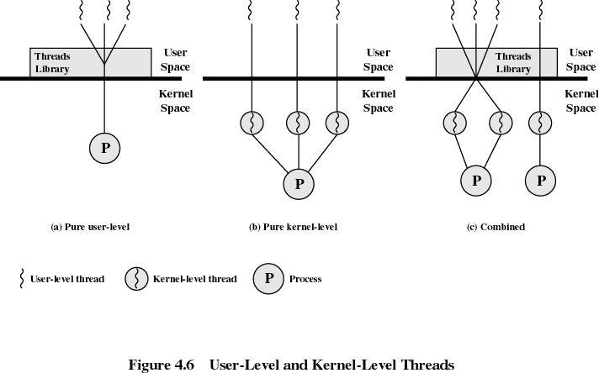

Slide 15
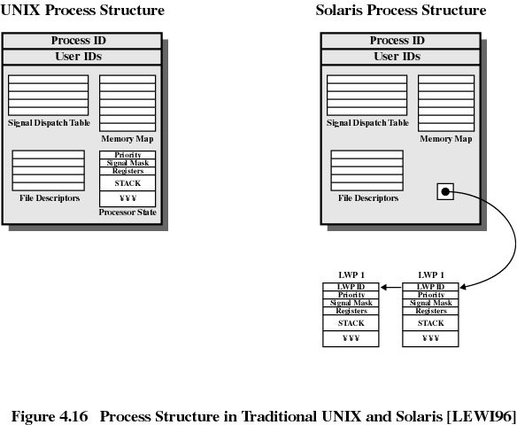

Slide 16
Solaris/Linux Thread Execution
Thread creation (pthread_create())
Synchronization
(pthread_mutex_lock(), pthread_mutex_unlock(), pthread_mutex_trylock() )
Suspension (pthread_cond_wait(), pthread_cond_signal(), pthread_join())
Yielding (pthread_yield())
Termination (pthread_exit())

Slide 17
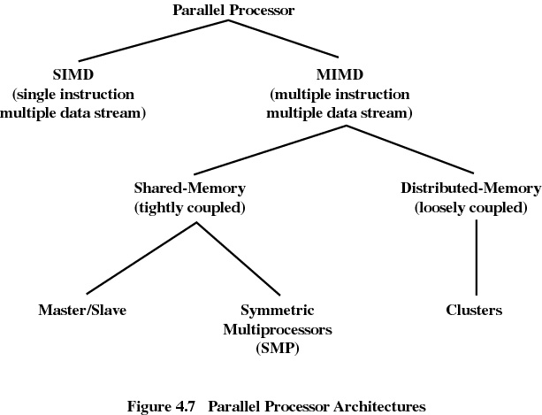

Slide 18
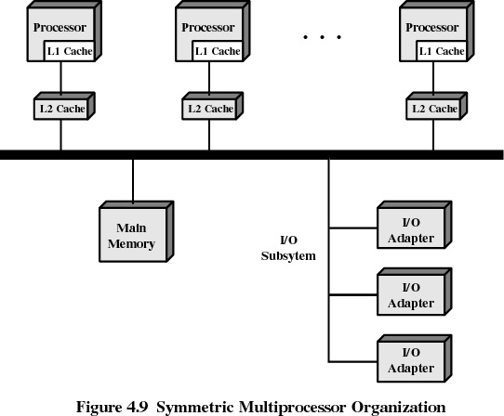

Slide 19
Symmetric Multiprocessing
Kernel can execute on any processor
Typically each processor does self-scheduling from the pool of available process or threads

Slide 20
Multiprocessor Operating System Design Considerations
Simultaneous concurrent processes or threads
Scheduling
Synchronization
Memory Management
Reliability and Fault Tolerance

